Slide 1
Workshop 10 – Finite Markov Decision Process
Advanced Analytics and Applications [AAA]
Information Systems for Sustainable Society (is3) | WiSo Faculty | Univ.-Prof. Dr. Wolfgang Ketter | 6/22/22

Slide 2
I
Multiple Choice Questions
II
Calculation
III
Programming

Slide 3
AAA Workshop
Question 1.1: Episodic MDP
What is the goal with episodic decision processes?
i. Maximize immediate reward
ii. Minimize steps to reach terminal state
iii. Maximize episode return

Slide 4
AAA Workshop
Question 1.1: Episodic MDP
What is the goal with episodic decision processes?
i. Maximize immediate reward
ii. Minimize steps to reach terminal state
iii. Maximize episode return

Slide 5
AAA Workshop
Question 1.2: Solving Markov Decision Process
How would you solve the MDP of playing chess?
i. Monte Carlo (model-free, complete episodes available)
ii. Dynamic Programming (model-based)
iii. Temporal-Difference (model-free, online)

Slide 6
AAA Workshop
Question 1.2: Solving Markov Decision Process
How would you solve the MDP of playing chess?
i. Monte Carlo (model-free, complete episodes available)
ii. Dynamic Programming (model-based)
iii. Temporal-Difference (model-free, online)

Slide 7
I
Multiple Choice Questions
II
Calculation
III
Programming

Slide 8
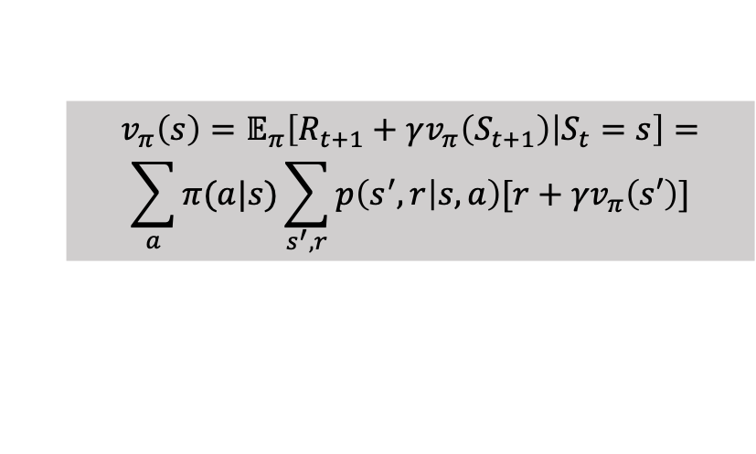
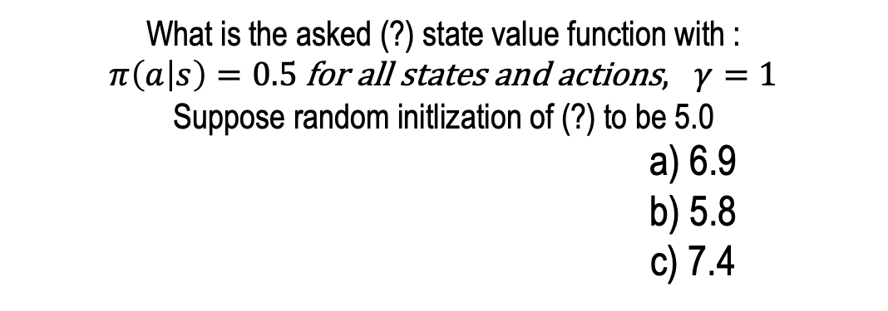
AAA Workshop
What is the asked (?) state value function with :
$π\left(a | s\right)=0.5$for all states and actions$, γ=1$
Suppose random initlization of (?) to be 5.0
a) 6.9
b) 5.8
c) 7.4
Question 1.2: Solving Markov Decision Process
Facebook
R = -1
The Think:Act will be out by the end of this month …
-2.3
0
Study
R = 10
Quit
R = 0
Facebook
R = -1
Sleep
R = 0
Study
R = -2
-1.3
2.7
?
Study
R = -2
Pub
R = 1
$$v_{π}\left(s\right)=𝔼_{π}\left[R_{t+1}+γv_{π}\left(S_{t+1}\right) | S_{t}=s\right]=$$
$$\sum_{a}{π(a|s)\sum_{s^{′},r}{p\left(s^{′},r | s,a\right)[r+γv_{π}\left(s′\right)]}}$$
0.4
0.2
8
0.4

Slide 9

$$V_{π}=0.5∗\left(1+0.2∗−1.3+0.4∗2.7+0.4∗5.0\right)+0.5∗10$$
$$V_{π}=6.91$$
Facebook
R = -1
The Think:Act will be out by the end of this month …
-2.3
0
Study
R = 10
Quit
R = 0
Facebook
R = -1
Sleep
R = 0
Study
R = -2
-1.3
2.7
?
Study
R = -2
Pub
R = 1
0.4
$$v_{π}\left(s\right)=𝔼_{π}\left[R_{t+1}+γv_{π}\left(S_{t+1}\right) | S_{t}=s\right]=$$
$$\sum_{a}{π(a|s)\sum_{s^{′},r}{p\left(s^{′},r | s,a\right)[r+γv_{π}\left(s′\right)]}}$$
0.2
9
0.4

Slide 10
I
Multiple Choice Questions
II
Calculation
III
Programming

Slide 11
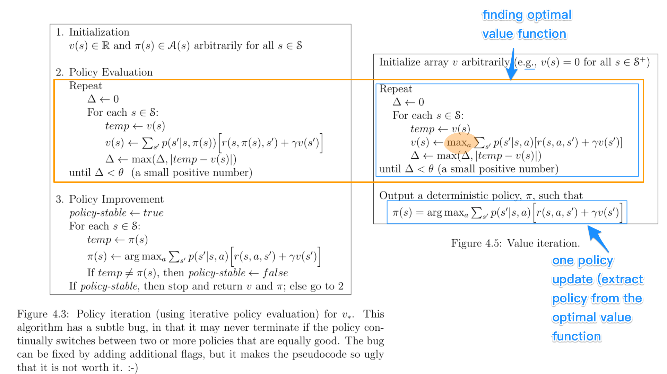

Slide 12
Contact
For general questions and enquiries on research, teaching, job openings and new projects refer to our website at www.is3.uni-koeln.de
For specific enquiries regarding this course contact us by sending an email to the IS3 teaching address at is3-teaching@wiso.uni-koeln.de

